Slide 1
PRESENTATION TITLE CAN
BE UP TO TWO LINES
PRESENTATION SUBTITLE CAN BE A SINGLE LINE or
EXTEND TO TWO LINES
MONTH DAY, 20XX
PRESENTER NAME 1, TITLE
PRESENTER NAME 2, TITLE
PRESENTER NAME 3, TITLE
PRESENTER NAME 4, TITLE

Slide 2


MTF Biologics is a global nonprofit organization that saves and heals lives by honoring donated gifts, serving patients, and advancing science.

Slide 3




MTF Biologics – Who we are
We uphold the highest standards, we provide exceptional service, resources, and expertise to:
Donors and their loved ones who give the gift of tissue donation
Patients who depend on tissue and organ transplants
Healthcare providers who care for donors and recipients
Clinicians and researchers advancing the science and medicine of transplantation

Slide 4

MTF Biologics – What we believe
Tissue and organ transplantation, related research, and innovation hold vast potential to save and heal lives
Fully integrating service, science, and advocacy unleashes our ability to
improve healthcare and wellbeing for the future
Restoring the body to health can rejuvenate the spirit

Slide 5




MTF Biologics – Values
At MTF Biologics, we:
Transform
We provide safe, high-quality grafts from donated human tissues that are used in a growing array of clinical fields.
Collaborate
We forge relationships with experts in tissue and organ recovery, as well as leading physicians and scientists, to accelerate innovation and ensure the best possible experiences and outcomes for patients.
Innovate
We advance the science of transplantation by supporting research within our own organization and among clinicians and researchers worldwide.
Give back
We advance the science and medicine of transplantation by providing grants that fund groundbreaking research. We provide donated tissues for humanitarian efforts including responding to national and international emergencies and natural disasters.

Slide 6



MTF Biologics – Our colleagues
We are proud to work with:
The International Institute for the Advancement of Medicine (IIAM), a division of MTF, honors donors of non-transplantable organs and tissue by providing their gifts to the medical research community to combat and cure disease.
Statline, a division of MTF Biologics, provides specialized communications and technology expertise to organ, tissue and eye procurement organizations, as well as the hospital and patients they serve.
The German Institute for Cell and Tissue Transplantation (DIZG), our sister organization, further expands our global reach to patients around the world.

Slide 7






MTF Biologics – Fast facts
> 9 Million allografts distributed
> 130,000 tissue donors processed
0% viral disease transmission in our
30 year history
> 100 peer-reviewed publications
> 80 issued and pending US patents
> $55 Million in research funding
Every minute of every day, an MTF Biologics
allograft is used to save or heal a life.

Slide 8
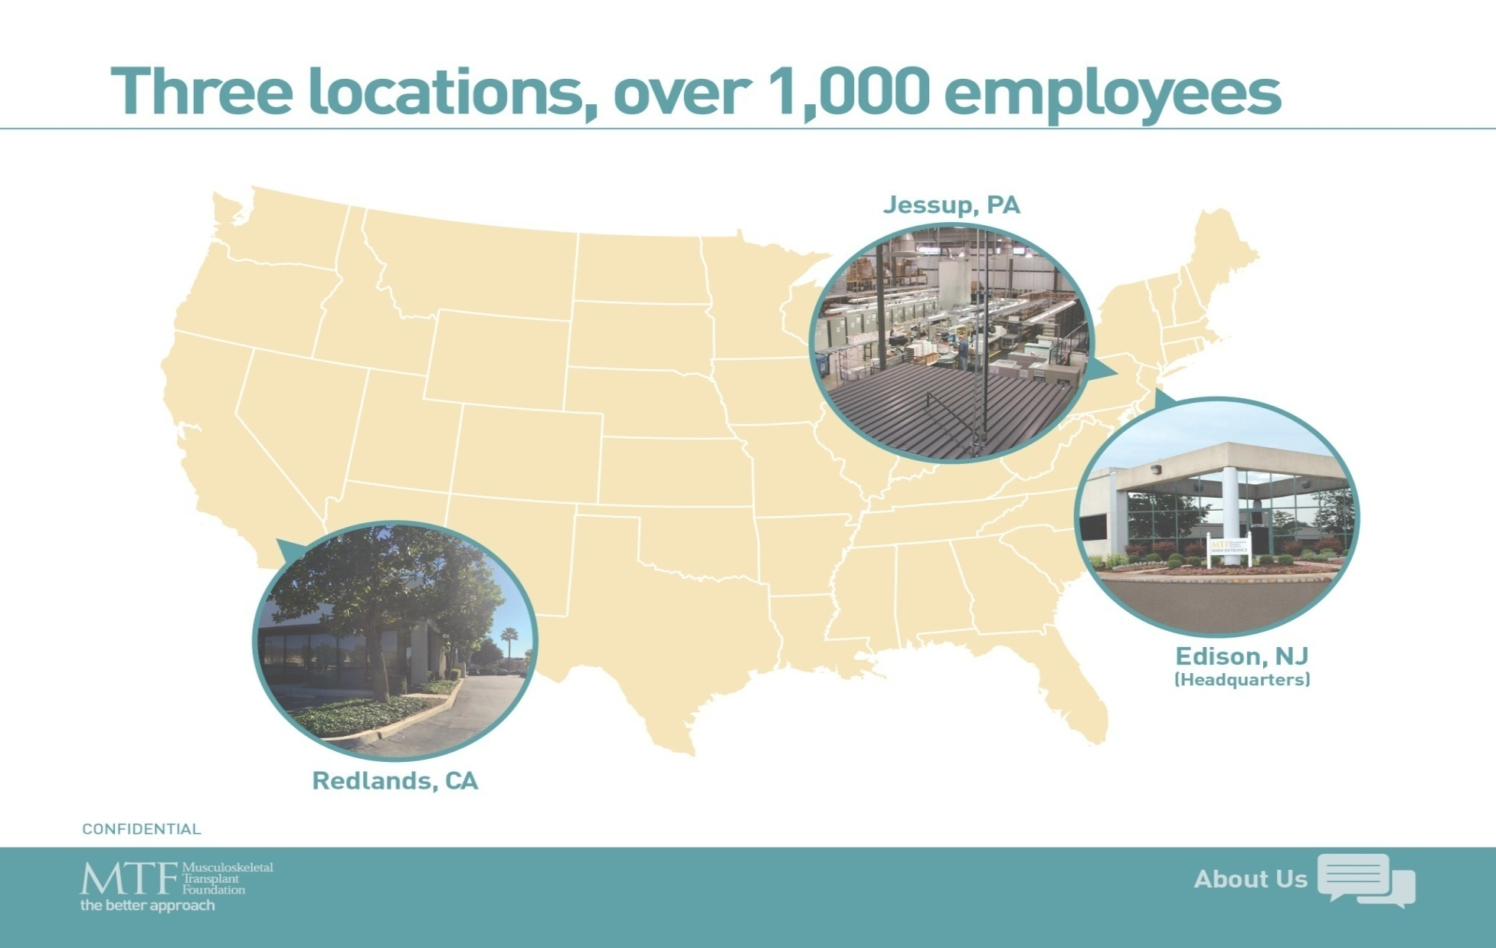
MTF Biologics – Locations

Slide 9
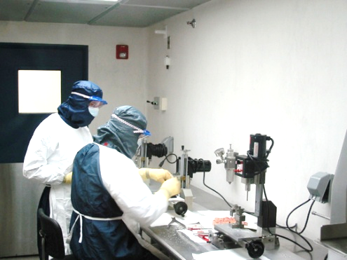
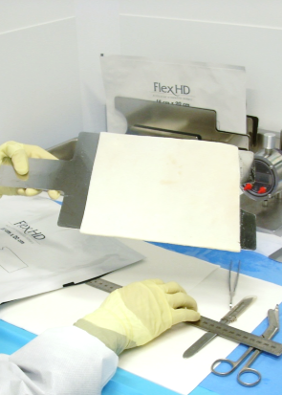
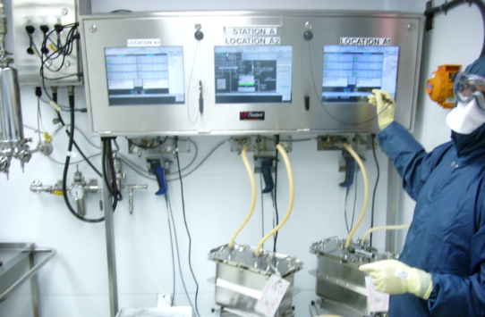
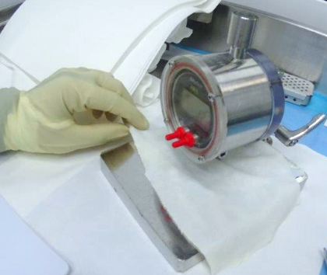
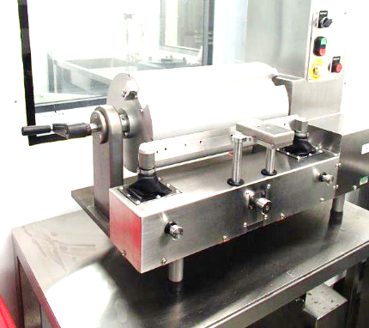
Our Mission – Stewards of the Gift
Tissue is handled and processed with respect and care
Meticulous recovery and processing techniques ensure sterility and high quality
Innovation and research
ensures we honor and
make the most of the gift

Slide 10
When you choose a tissue from MTF Biologics…
You choose…
  The highest quality tissue available
  Tissue developed and backed by surgeons
  To support medical research in tissue regeneration
  To support mission trips all over the world
  High quality educational support for your teams
  To support the distribution of life healing and life saving allografts

Slide 11



Advancing Science
How We Give back
Our commitment to research and the exploration of new ideas to drives us
Professional Education
Mission support
Peer reviewed grant program
More than $55 Million awarded worldwide
$1M Plastic Surgery Foundation grant support
Technical Education Forums
National Symposia
On-line, webinar series
Peer to peer
CEU Programs
Providing donated tissues for research and humanitarian efforts including responding to national and international emergencies as well as natural disasters

Slide 12





MTF Biologics – Business Segments
Sports Medicine
Bone & Spine
Graft Matching
Plastics & Aesthetics
Reconstructive & Regenerative
Acute Wounds
Chronic Wounds
Complex Wounds
Our Distribution Partners:

Slide 13

MTF Biologics – Professional Education

Slide 14

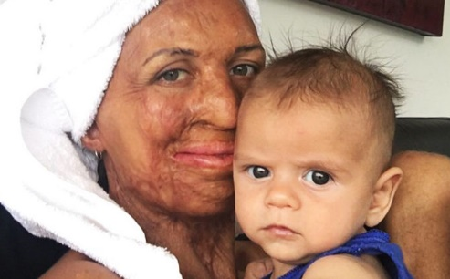
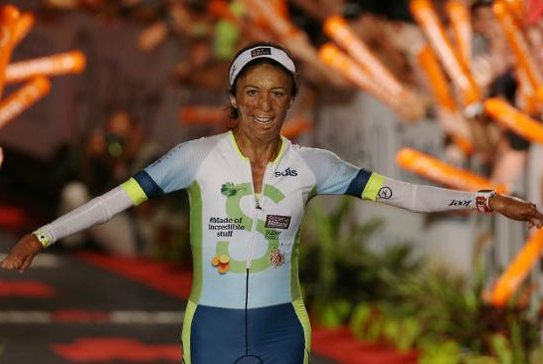
Tissue Recipient – Burn survivor
“Without the generosity and grace of 16 Americans who donated tissue, I would not be here today. MTF Biologics literally saved my life.”
- Turia Pitt, Skin Graft Recipient
Australian athlete, author, and mother

Slide 15
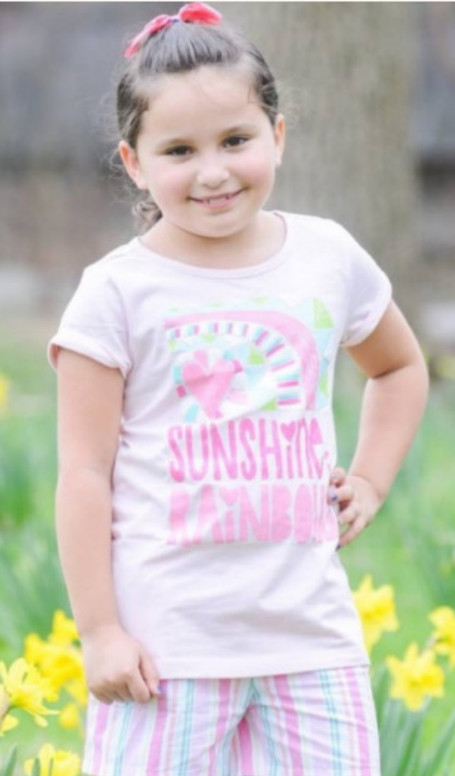
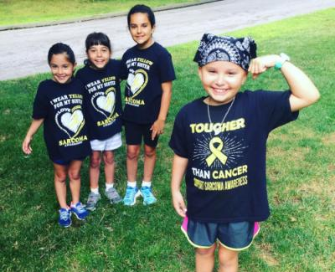
Tissue Recipient – Osteosarcoma survivor
“Thank you to my donor family for their special gift that helped me get better,” she said. “I now have movement in my arm which allows me to do all the activities I could do before I had cancer. I can now play soccer and swim again. It means everything to me that you were so nice to give me the gift of donation.”
- Dylan Vitucci, Bone Graft Recipient and fearless fighter of osteosarcoma

Slide 16
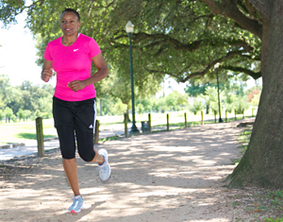
Tissue recipient – Breast cancer survivor
“I've always been a donor. I registered a long time ago but feel honored to be part of the receiving end of this cycle of giving. I've always been a giver, but this has awakened me to a whole new level of gratitude for the generosity of such a gift"
- Mary Louis, Breast Cancer Survivor

Slide 17

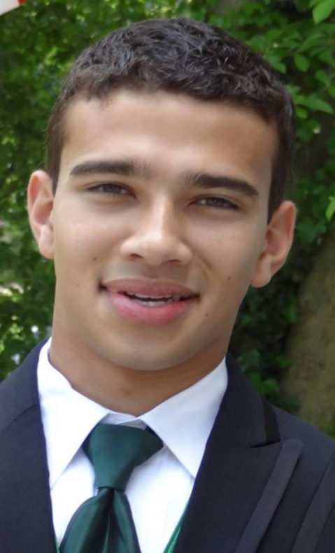
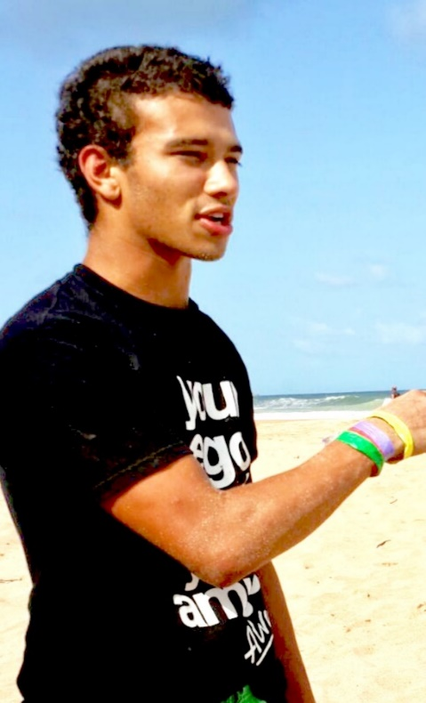
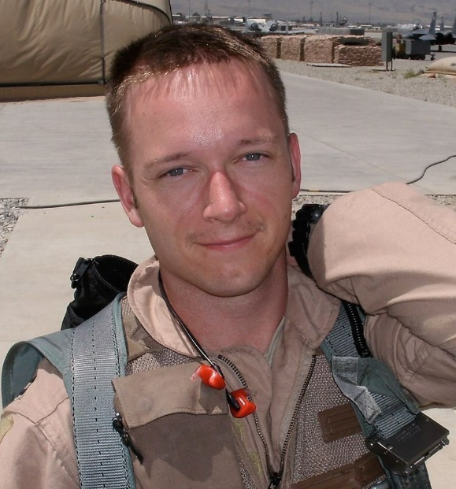
The Faces of Tissue Donation
Leah Brown
Tissue and Cornea Donor
Jonathan Baksh
Tissue Donor
Major Benjamin Meier
Organ and Tissue Donor

Slide 18
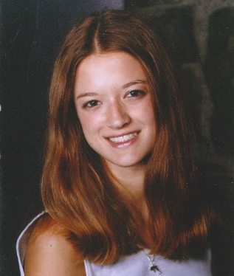
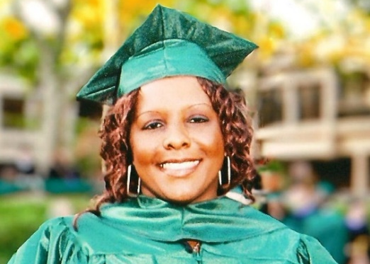
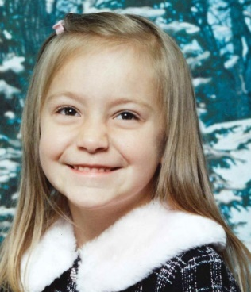

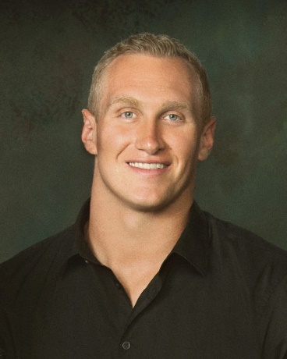

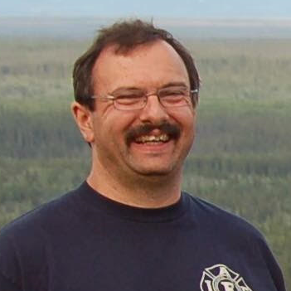

MTF Biologics – Our Core Purpose
We save and heal lives by honoring donated gifts, serving patients, and advancing science.

